Slide 1





Social Media
Optimization
Marketing Team

Slide 2


Agenda
Intro about dataset
Objectives
Questions We need To Answer!
Insights!

Slide 3


About Dataset
The Company conducted three marketing campaigns (Fall, Summer, and Spring) across three platforms (Facebook, Instagram, and Pinterest) in three cities (Birmingham, London, and Manchester).
We targeted desktop and mobile users with two ad types: collection and discount.
For each campaign, we have data on impressions, conversions, clicks, likes, comments, shares, spend money, and total conversion money. This data is broken down by platform, city, device type, and ad type

Slide 4
Objectives
Our goal is to extract valuable insights from this data to understand which campaigns, platforms, and cities performed best and identify any key patterns or trends

Slide 5

Questions!
Campaign Performance
Which campaign generated the highest ROAS?
Did any campaign have a significantly higher conversion rate than the others?
Which campaign had the most engagement (likes, comments, shares)?

Slide 6

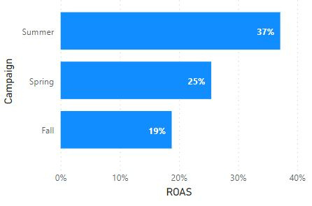
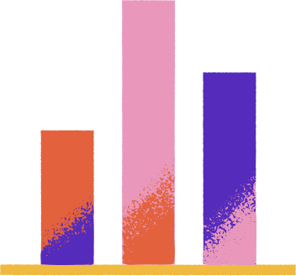
Results
The Summer campaign has the highest ROAS
ROAS measures the return on investment for your advertising campaigns. It tells you how much revenue you generate for every EGP spent on advertising.

Slide 7
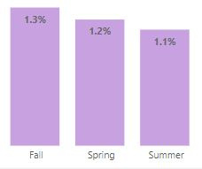
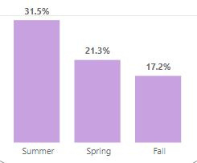
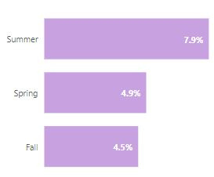
Summer Campaign has the highest conversion rate despite the lowest CTR compared to other campaigns
Results
The Summer Campaign might have been exceptionally well targeted, reaching a segment of users who were highly predisposed to converting.
Even if fewer people clicked on the ads, the ones who did were more likely to be in your ideal customer profile.
CTR
Conversion Rate
Engagement Rate

Slide 8
Questions!
Platform Performance
Did any channel have a significantly higher cost per acquisition
Compare the CPA for each platform
Which platform had the highest conversion rate and CTR?

Slide 9
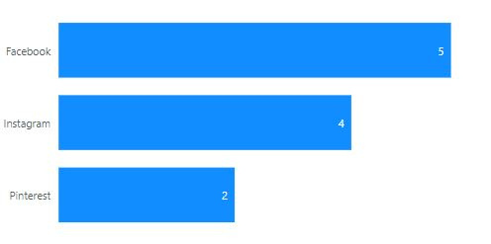
CPA (Cost Per Acquisition)
Results
It's a key metric in marketing that tells you how much you spend to acquire a new customer or achieve a specific conversion goal
The Facebook channel has the highest CPA
A higher CPA might suggest that your ads are not effectively targeting the right audience or that your channel is not optimized for conversions
The Pinterest channel has the Lowest CPA
A lower CPA generally indicates that your advertising channel are more efficient, as you're acquiring new customers or conversions at a lower cost.

Slide 10
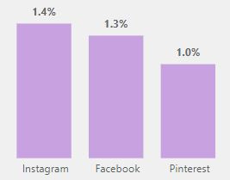
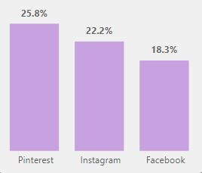
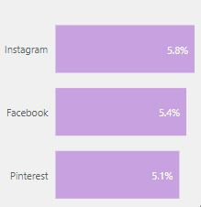
Pinterest has the highest conversion rate despite the lowest CTR compared to other channels
Results
CTR
Conversion Rate
Engagement Rate

Slide 11




Insight!
Interestingly, Pinterest has a high conversion rate despite a low CTR.
This suggests that while fewer people click on Pinterest ads, those who do are highly motivated to purchase.

Slide 12
Insight!
"While Instagram achieved the highest click-through rate (CTR) among our platforms, it wasn't the top performer in terms of conversion rate. However,
Instagram generated the highest profit, surpassing even Pinterest. This suggests that Instagram's audience, despite not converting at the highest rate, are highly valuable customers.
To maximize this potential, we should invest in customer segmentation to better understand and target these profitable Instagram users."

Slide 13
Questions!
Geographic Performance
Which city had the highest conversion rate?
Did any city have a significantly higher cost per acquisition?
Compare the CPA for each City
Was there a noticeable difference in engagement levels between cities?

Slide 14
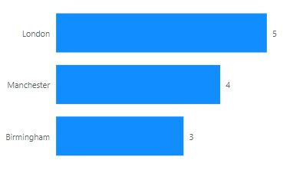
CPA (Cost Per Acquisition)
Results
It's a key metric in marketing that tells you how much you spend to acquire a new customer or achieve a specific conversion goal
London has the highest CPA
A higher CPA might suggest that your ads are not effectively targeting the right audience or
Birmingham has the Lowest CPA
A lower CPA generally indicates that your advertising Location is more efficient, as you're acquiring new customers or conversions at a lower cost.

Slide 15
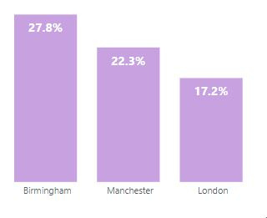
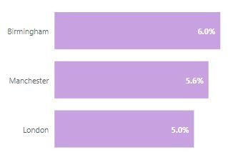
Results
Birmingham has the highest conversion and also the highest engagement rate
There is no noticeable difference in engagement levels between cities
Conversion Rate
Engagement Rate

Slide 16
Questions!
Device Performance
Were conversions higher on desktop or mobile devices?
Was there a difference in cost per acquisition between desktop and mobile? Compare the CPA for each device type
Did users on one device type engage more with ads than the other?

Slide 17
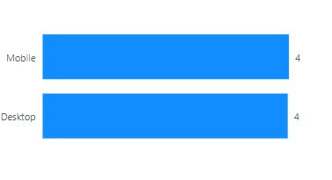
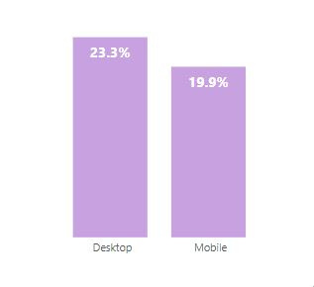
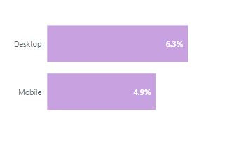
there is no significant difference in cost per acquisition between desktop and mobile.
Customers who use desktop devices have highest conversion and engagement rate
Results
CPA
Conversion Rate
Engagement Rate

Slide 18
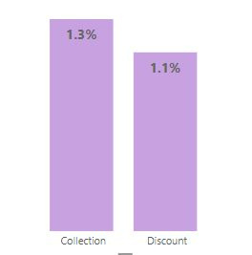
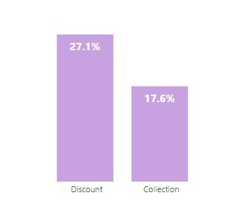
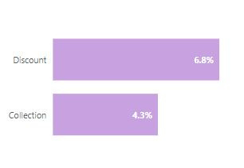
Questions!
Ad Type Performance
Which ad type (collection or discount) had the highest conversion rate?
Was there a difference in engagement between ad types?
CTR
Conversion Rate
Engagement Rate

Slide 19
Insights!
"While Collection ads attract the most clicks (highest CTR), customers are ultimately more likely to convert after seeing Discount ads. This is reflected in the higher conversion rate for Discount ads compared to Collection ads.
Additionally, engagement rates are significantly higher for Discount ads, indicating a stronger interest and responsiveness from the audience. This suggests that while Collection ads pique interest, Discount ads are more effective in driving actual purchases. Therefore, optimizing our strategy to prioritize and amplify Discount ads could lead to a greater return on investment."

